Slide 1



Zensar Technologies
Bharati Vidyapeeth (Deemed to be) University
College of Engineering,Pune
DEPARTMENT OF COMPUTER ENGINEERING
Internship At:
Pune 2019
By-
NAME: SHUBHANKAR GUPTA
ROLL NO: 15
PRN: 1614110139
CLASS: B.Tech Sem-VII Computer Engineering

Slide 2
Implant Training
In Plant Training for students to enrich their knowledge on Software, Hardware and Networking.
Provide them exposure in real time Industry Knowledge.
Trainers are delivering a relevant and guided learning skill that combines Lecture and practice to deliver what you need to know about a product or technology.

Slide 3
OUTLINE
Core Java
Advanced Java
Web Technologies : HTML,CSS & JS
Project: DREAM SOCCER LEAGUE

Slide 4
Core Java Content
Phases of Project Development
Getter and Setter methods
Java Virtual Machine (JVM)
Constructors
Java Beans
Abstract keyword, Method & Class
Interface
Steps of Project Creation

Slide 5
Java – Content Cont.…
Exception Handling
Assertion
Inner Classes
Constructors
Multi Threading
Synchronization
File Systems
RDBMS

Slide 6

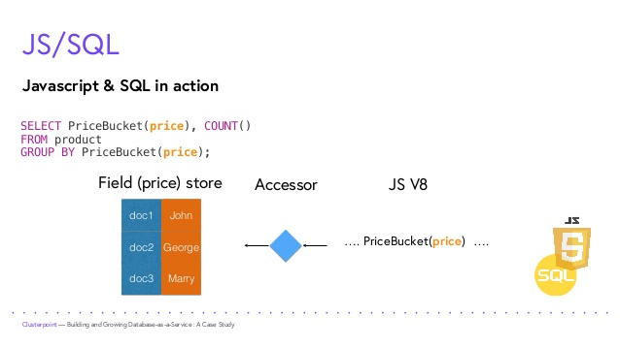
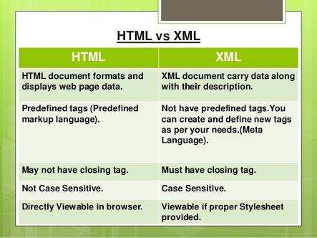

Slide 7
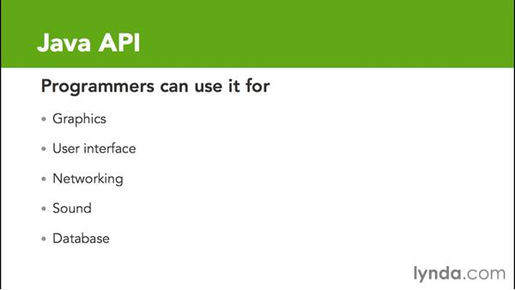

Slide 8
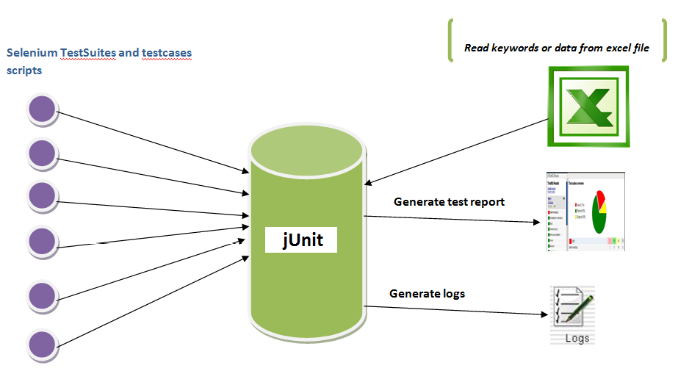

Slide 9
Advanced Java Contents
Client Server Architecture
HTTP Protocol
Servlets
Servlet Life Cycle Methods
Web.xml
Servlet Collaboration
Filters & Listeners
Session Tracking

Slide 10
Advanced Java Contents Contd…
MVC (Model View Controller)
Filters
Interface
Grammar of JSP
Scriptlets
JSP Centric MVC
Listeners
Session Tracking

Slide 11
Web Technologies
Basics of HTML
Static Web Page
Website
Basics of CSS
Types of CSS
Website
Java Script
Implementation of JS in form
Basics Of Angular

Slide 12
DREAM SOCCER LEAGUE
JAVA BASED WEB APPLICATION
THIS PROJECT CONSTITUTES THREE MODULES:
1. ADMIN MODULE
2. TEAM MODULE
3. USER MODULE
IN THE ADMIN MODULE THE ADMIN CAN LOG IN AND SIMULATE THE
MATCHES BETWEEN THE REGISTERED TEAMS
IN THE TEAM MODULE FIRST A TEAM IS REGISTERED USING A SIGN IN
PAGE. THE TEAMS CAN VIEW THE LEAGUE TABLE AND THE FIXTURES.
IN THE USER MODULE A USER CAN SIGN IN THE APPLICATION BY FILLING
HIS/HER DETAILS.
CAN MAKE HIS OWN TEAM OF 5 PLAYERS BY CHOOSING BETWEEN THE
CURRENTLY PLAYING 2 TEAMS.

Slide 13
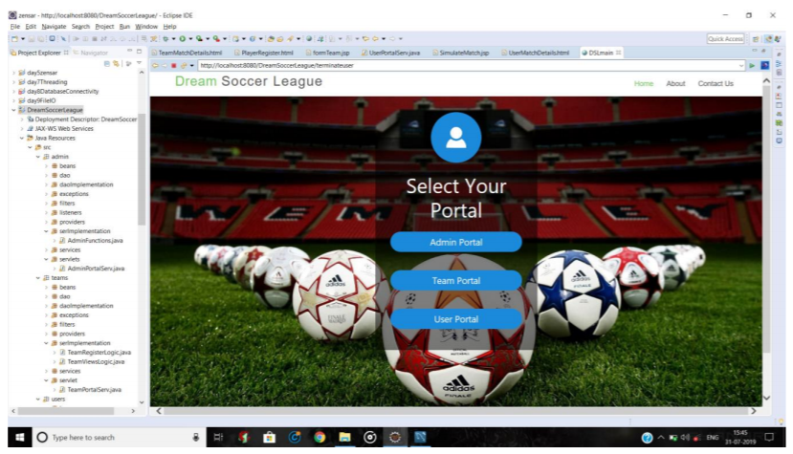
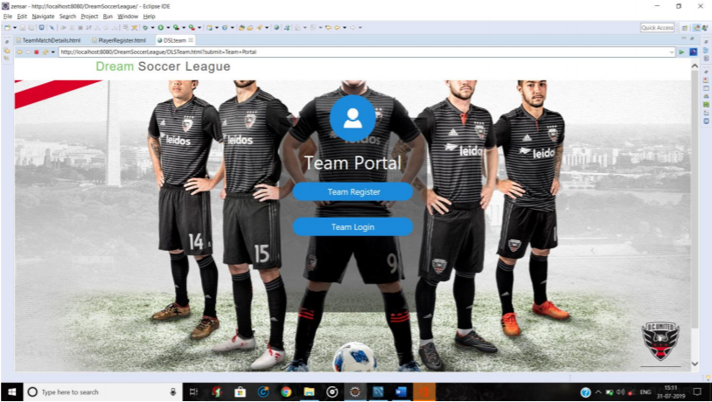
Project Implementation

Slide 14
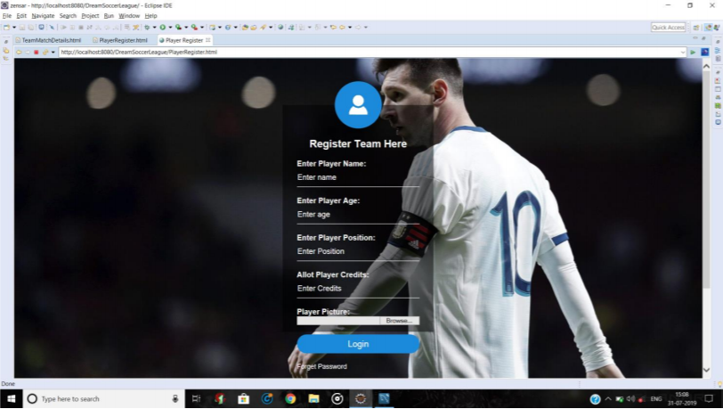
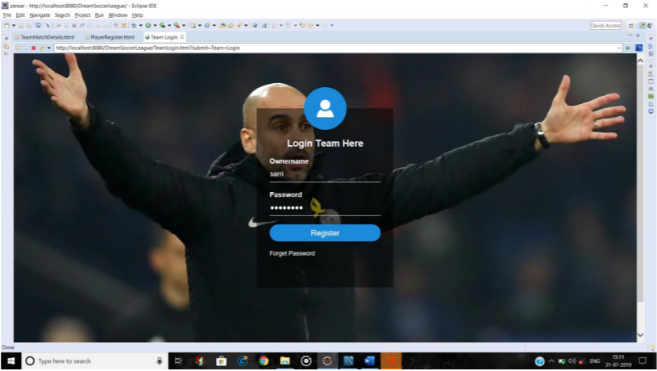

Slide 15
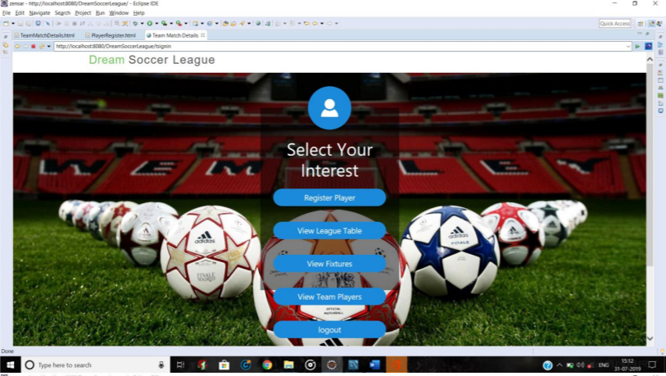
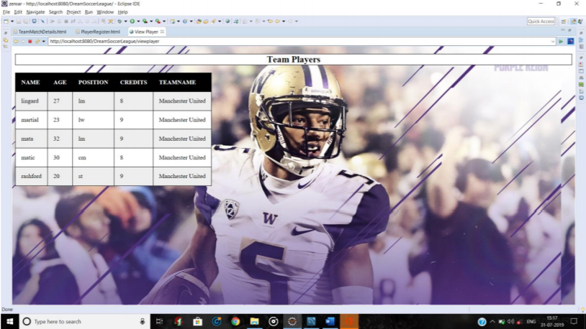

Slide 16
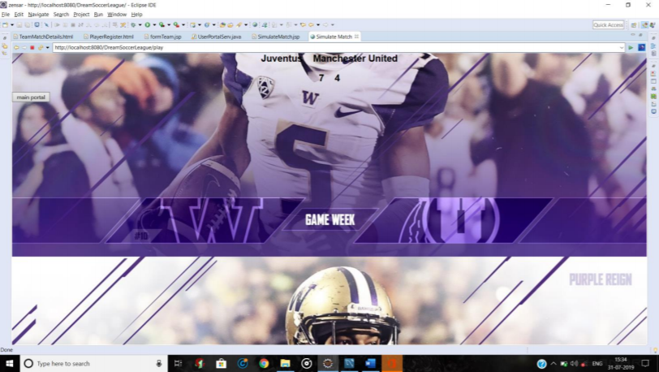
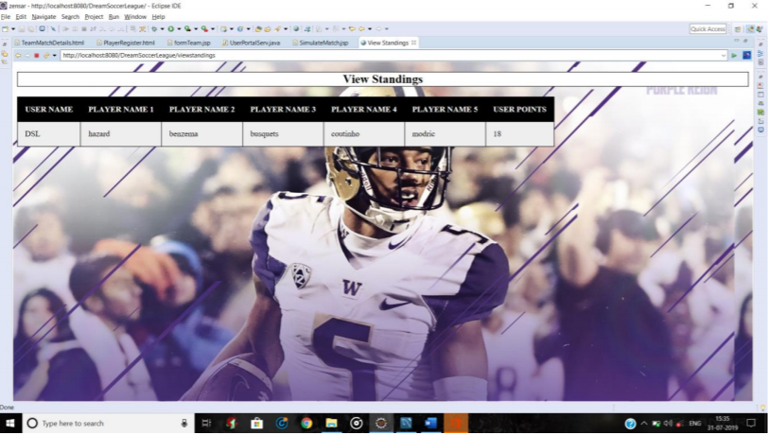

Slide 17
Conclusion
Industrial Training program in Zensar Technologies had given opportunities to us to prepare ourselves as future IT experts, which has helped us to improve our hands on experience.

Slide 18
THANK YOU

